Slide 1
Standards Update
Charles Severance
Longsight
University of Michgan

Slide 2


Disclaimer
What I am about to talk about is not an official direction or position of the University of Michigan, Longsight, nor IMS Global.

Slide 3
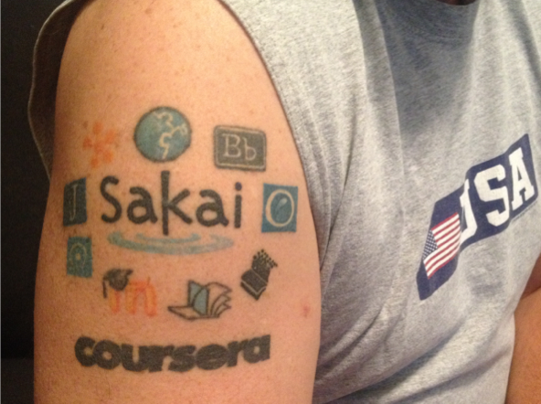
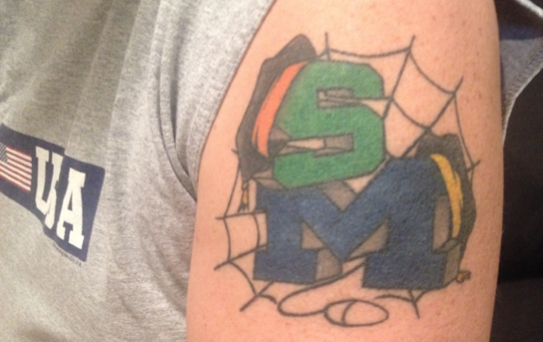
Research
Academics

Slide 4
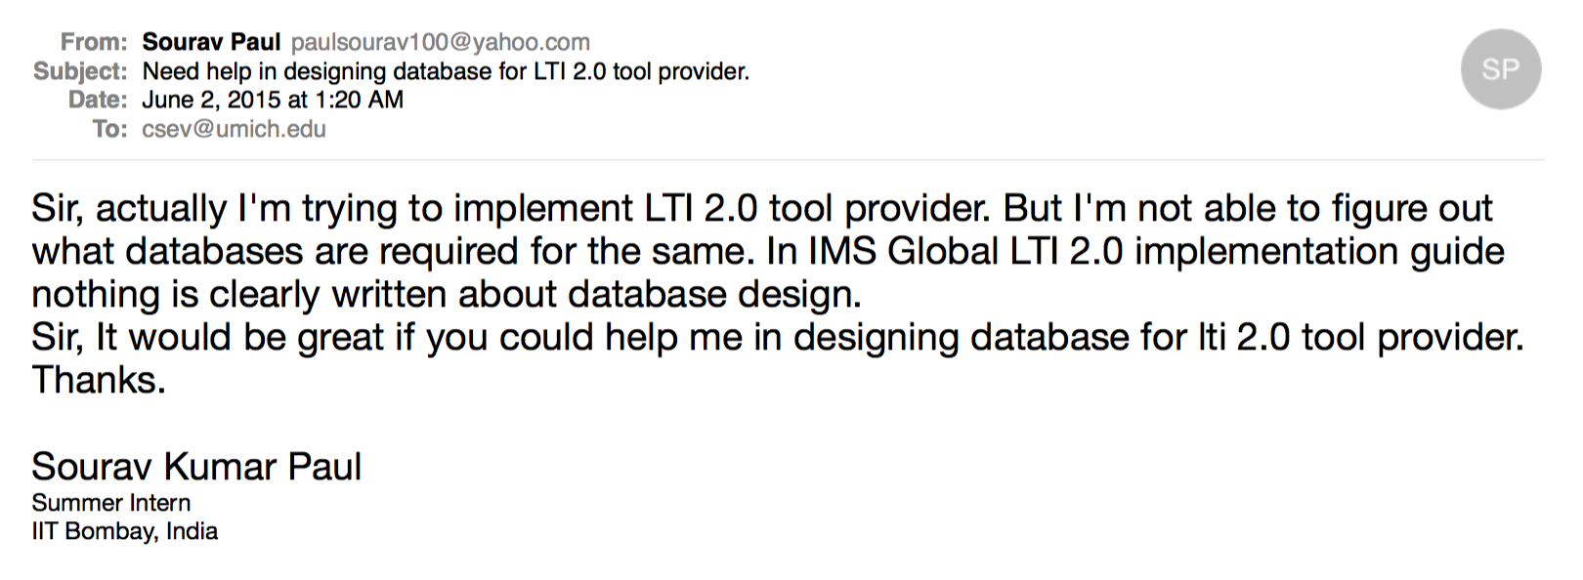


Slide 5
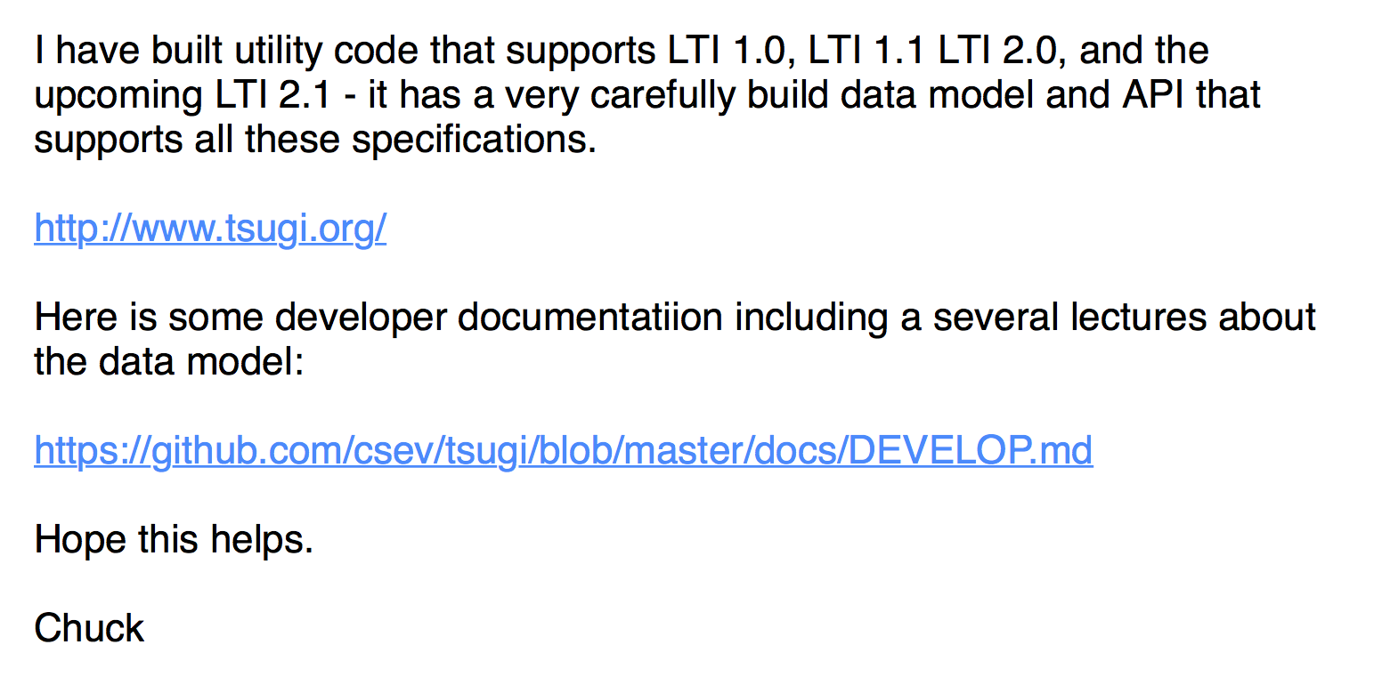

Slide 6
A Little History

Slide 7
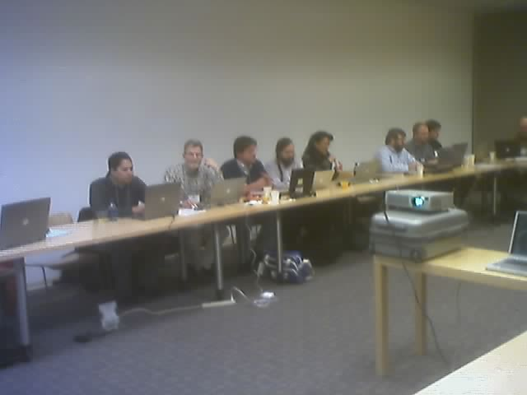
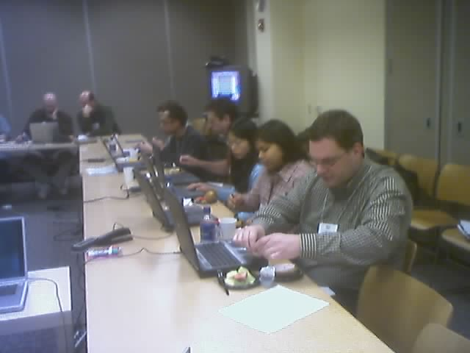
February 19, 2004
Sakai All Hands Meeting @ Stanford

Slide 8
At 02:28 PM 3/2/2004 -0500, Chris Etesse wrote:
Chuck, Jeff and Babi,
It was my pleasure talking to you both during my travels recently - Chuck in person in Edinburgh and Jeff & Babi via phone from Europe. As promised, I wanted to pass on a link to a white paper we just released on Blackboard & Standards as well as restate my invitation to host a meeting at Blackboard with Chuck to discuss how we can interoperate going forward. Finally, the second link is to the Blackboard SDK's for our various products - I thought it might be of some interest. I look forward to working closer with you each.
Warmest regards,
Christopher Etesse
Senior Director of Technology
Blackboard Inc.

Slide 9
DRAFT Software Portability Workgroup Prospectus DRAFT
The current trend in web-based systems for eLearning has been moving steadily towards increasing componentization and modularity. This trend is driven to a large extent by the desire for systems deployers to easily enhance system functionality to more quickly and effectively support the maturing demands of LMS users. Three notable examples are referenced here:
Blackboard Building Blocks
Sakai’s Tool Portability Profile
WebCT PowerLinks SDK
Joseph Hardin
University of Michigan
September 3, 2004

Slide 10
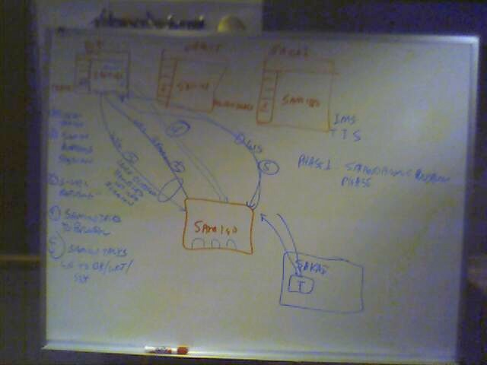
Brainstorming at IMS Meeting in Denver 2004-10-19

Slide 11
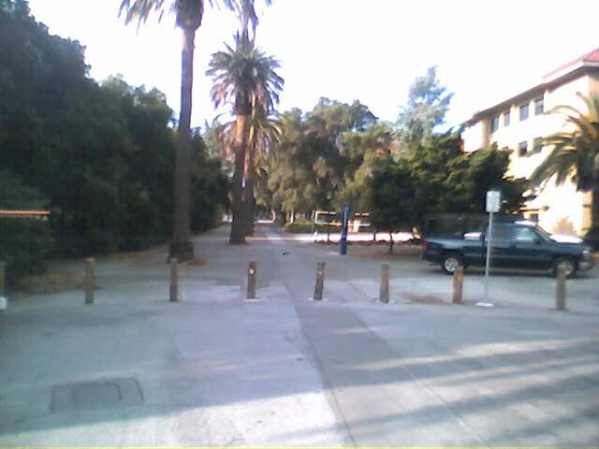
Publisher Meeting @ Stanford
Colleagues:
It looks like we have about 25 individuals (give or take) attending the SCP/SCA/Board meeting on 4/27/2005 from 1-5 pm. This includes the Board (9). See list below. At this point, I'd rather not invite any more people.
Textbook Publishers Invited/Attending...............................................
Allen Noren, O'Reilly & Associates -- ATTENDING
Ray Henderson, Pearson Education -- ATTENDING
Schoen, Steve, Thomson Higher Education -- ATTENDING
David Serbun, Houghton Mifflin Company -- ATTENDING
Jonathan Stowe, John Wiley & Sons, Inc. -- ATTENDING
Glenn Kammen, Intelecom -- ATTENDING
Vivian 'Vivie' Sinou
Dean, Distance & Mediated Learning
Foothill College

Slide 12
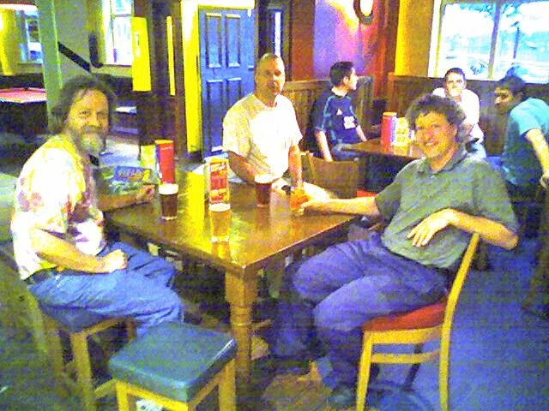
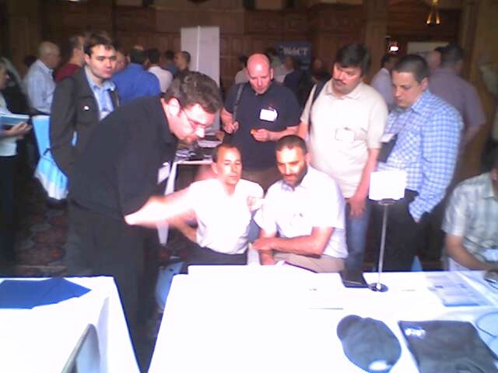
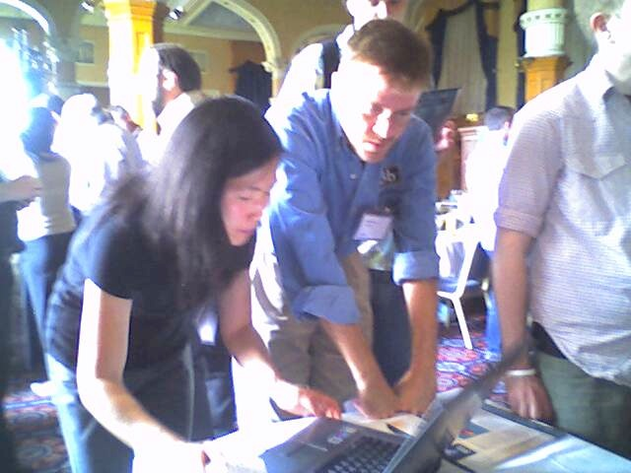
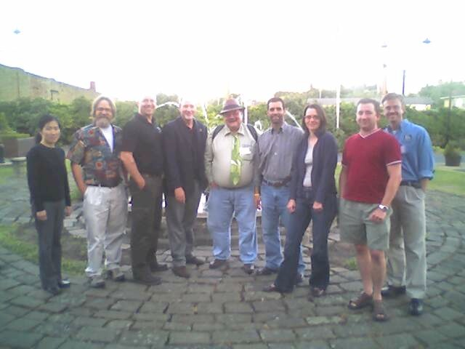
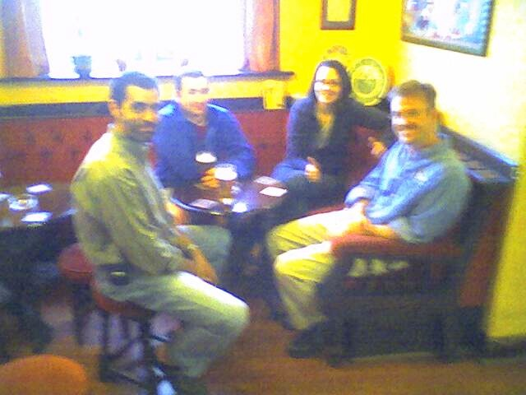
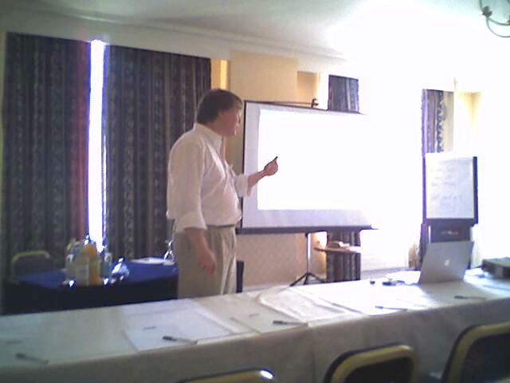
June 21, 2005,
IMS Alt-I-Lab Sheffield, UK

Slide 13
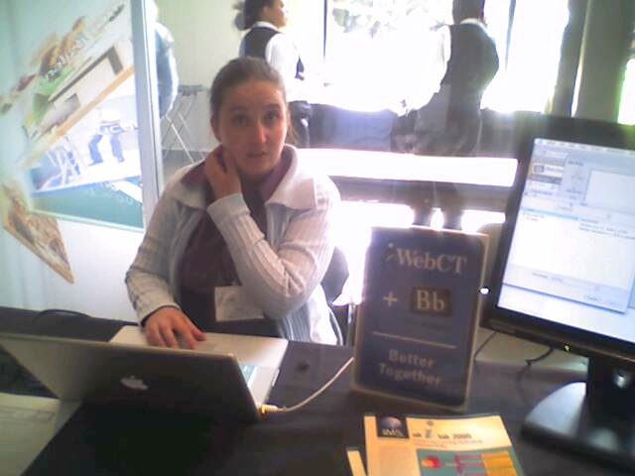
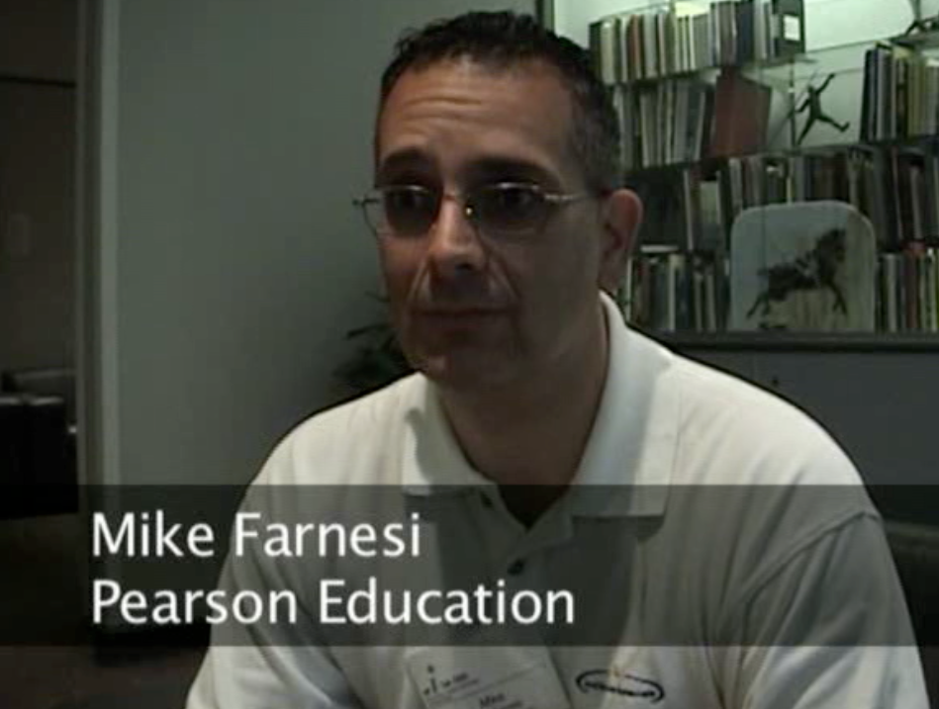
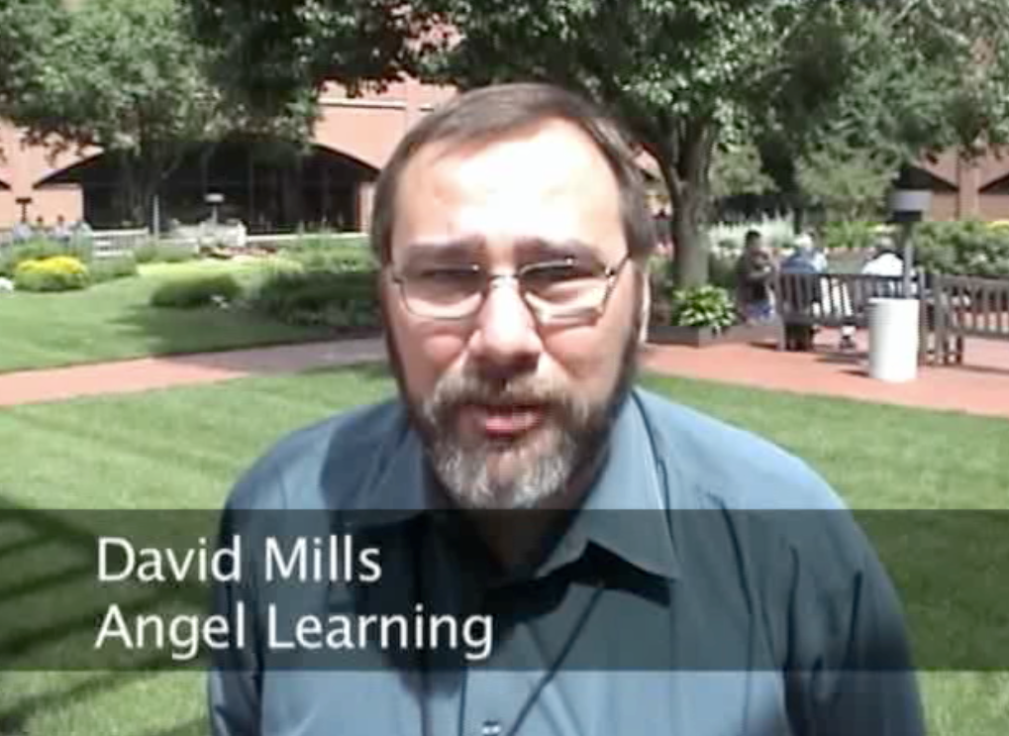
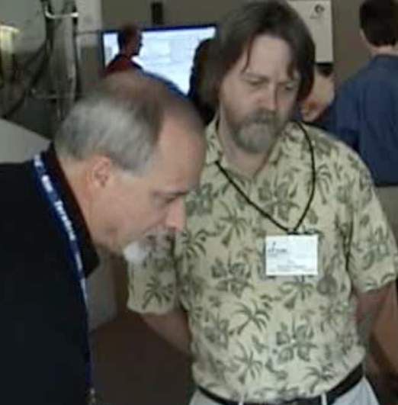
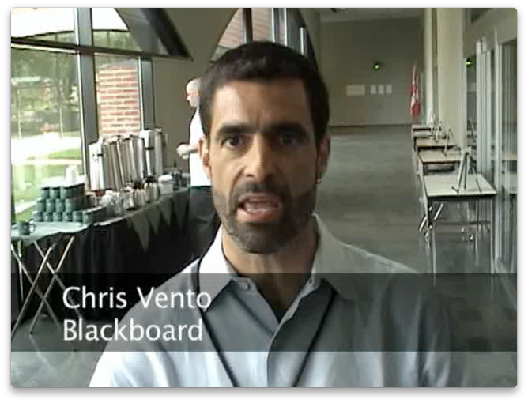
June 21, 2006
IMS Alt-I-Lab
Indianapolis, IN

Slide 14

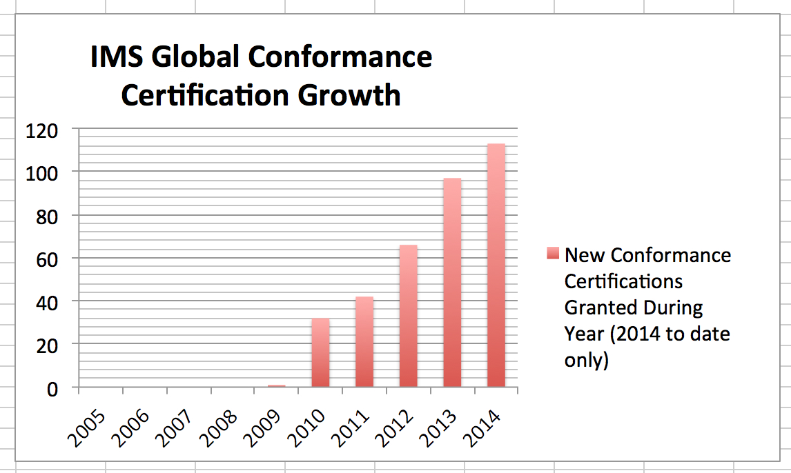
SIMPLE LTI
TI 1.0
LTI 1.0
LTI 1.1
LTI 2.0

Slide 15
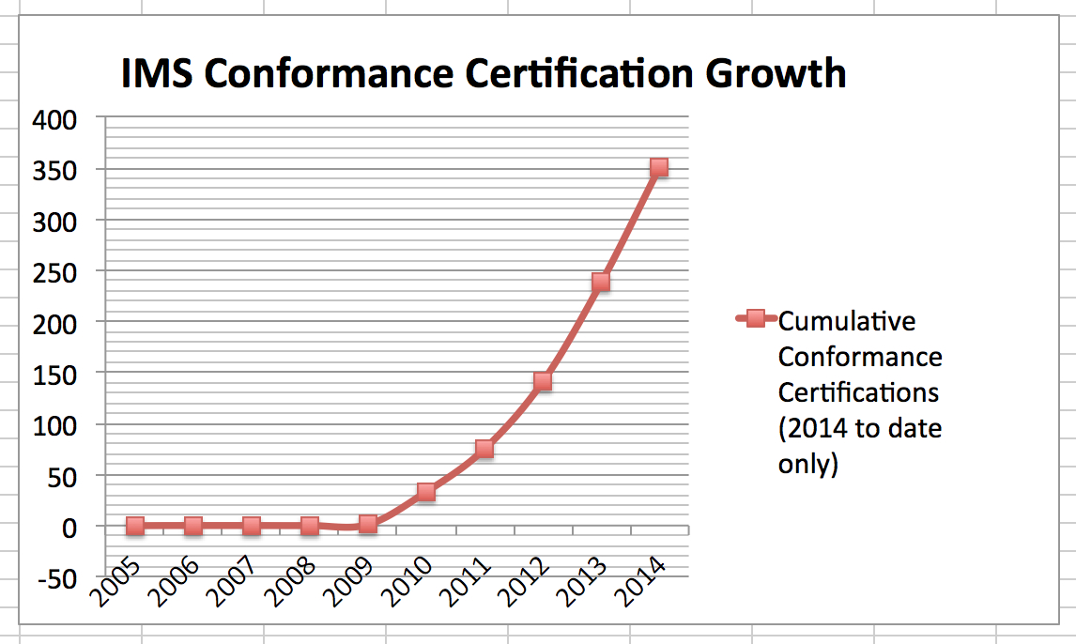

Slide 16

































Learning Platforms that Accept IMS Apps! http://imscatalog.org/
Notes:
ROB
Does LTI provide real evidence that there can be a single approach for integrating with multiple software platforms?
Yes, over 20 learning platforms accept LTI apps – and growing.
In addition, there are now over 100 certified LTI applications !!!
In fact there were close to 100 new certifications in 2013 alone.

Slide 17
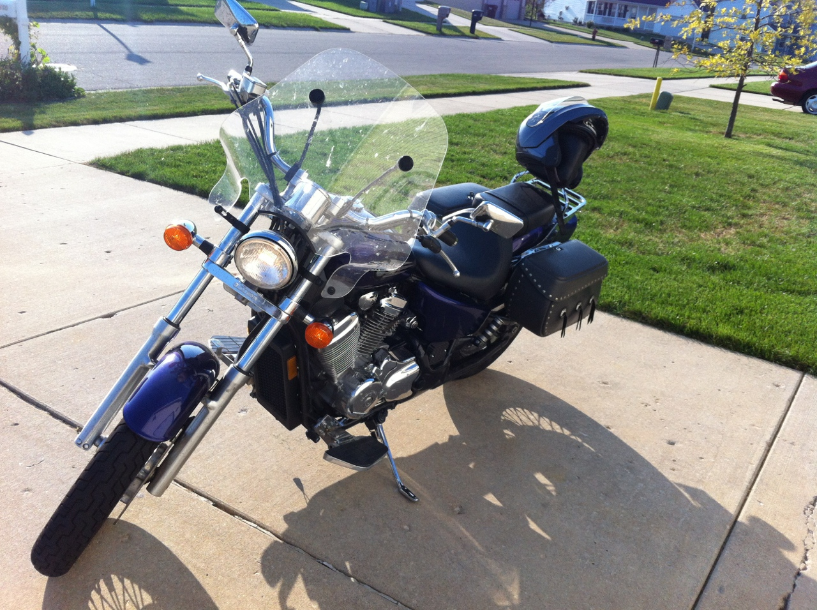
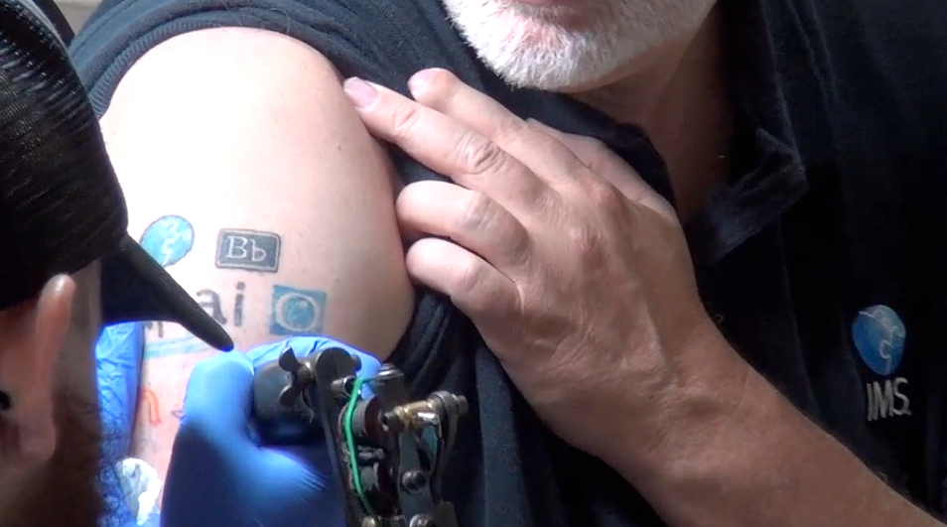
http://www.youtube.com/watch?v=VY-Ogkc7Mnw
July 2012

Slide 18
Important Standards
http://developers.imsglobal.org/

Slide 19
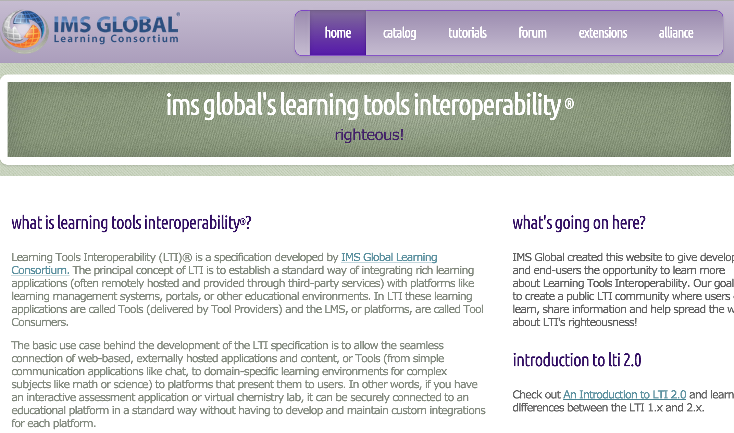
developers.imsglobal.org

Slide 20
Active Standards
IMS Learning Tools Interoperability 1.0, 1.1, 2.0, 2.1, 2.2
IMS LTI Content Item - Public Draft
IMS LTI Roster Services – WG Draft
IMS LTI Outcomes Services – in WG Draft
IMS Caliper - Public Draft any day now
IMS CASA – WG - Draft

Slide 21
Other Standards Activity
IMS Common Cartridge – 1.0, 1.1, 1.2, 1.3
IMS Common Cartridge – 2.0 – Working Group
IMS CC / EPUB 3.0 Coordination
IMS Learner Information Services (LIS) / School Interchange Format (SIF)
https://www.sifassociation.org

Slide 22
IMS Learning Tools Interoperability

Slide 23
Basic LTI (LTI 1.0) – May 2010
With LTI looking like it would take a long time, we needed a stop gap
We extracted the launch protocol from the (large) LTI draft and moved it forward
A POST of form data signed OAuth 1.0
Completed and released as LTI 1.0 May 2010
http://www.imsglobal.org/lti/blti/bltiv1p0/ltiBLTIimgv1p0.html

Slide 24
"Buy"
Approve
Set
Up
Final
URL, Key, Secret
Cut/
Paste
Install
Final
LTI 1.0
LMS
Tool

Slide 25
LTI 1.1 (March 2012)
We quickly added the ability to have a grade book row associated with a launch and a web service to set, retrieve, and delete that single grade
We used XML + OAuth Body Hashing
Desire2Learn was the first commercial LMS to implement LTI 1.1
http://www.imsglobal.org/LTI/v1p1/ltiIMGv1p1.html

Slide 26
"Buy"
Approve
Set
Up
Final
URL, Key, Secret
Cut/
Paste
Install
LMS
Final
Launch
0.9
0.9
Got It
LTI 1.1
Tool

Slide 27
<?xml version = "1.0" encoding = "UTF-8"?>
<imsx_POXEnvelopeRequest
xmlns="http://www.imsglobal.org/services/ltiv1p1/xsd/imsoms_v1p0">
<imsx_POXHeader>
<imsx_POXRequestHeaderInfo>
<imsx_version>V1.0</imsx_version>
<imsx_messageIdentifier>541c3492bf376</imsx_messageIdentifier>
</imsx_POXRequestHeaderInfo>
</imsx_POXHeader>
<imsx_POXBody>
<replaceResultRequest>
<resultRecord>
<sourcedGUID>
<sourcedId>81e0a730cf9b60ffacbf:::content:22</sourcedId>
</sourcedGUID>
<result>
<resultScore>
<language>en-us</language>
<textString>0.7</textString>
</resultScore>
</result>
</resultRecord>
</replaceResultRequest>
</imsx_POXBody>
</imsx_POXEnvelopeRequest>

Slide 28
Demonstration of LTI 1.1 and POX
https://online.dr-chuck.com/sakai-api-test/

Slide 29
LTI 2.0 (Final, January 2014)
REST/JSON architecture
Registration process:
profiles to share capabilities and available services
agree key and secret
Tool settings and Result services
Certified:
Vital Source (Tool Provider)
Sakai 10 (Tool Consumer)
Moodle (Tool Consumer)
http://www.imsglobal.org/lti/ltiv2p0/ltiIMGv2p0.html

Slide 30
JSON-LD – www.json-ld.org
RDF / Linked-Data meets Hacker-Friendly JSON
Depending on the application, you can look at it as a collection of linked triples or just a clean serialization of a REST-Style resource

Slide 31
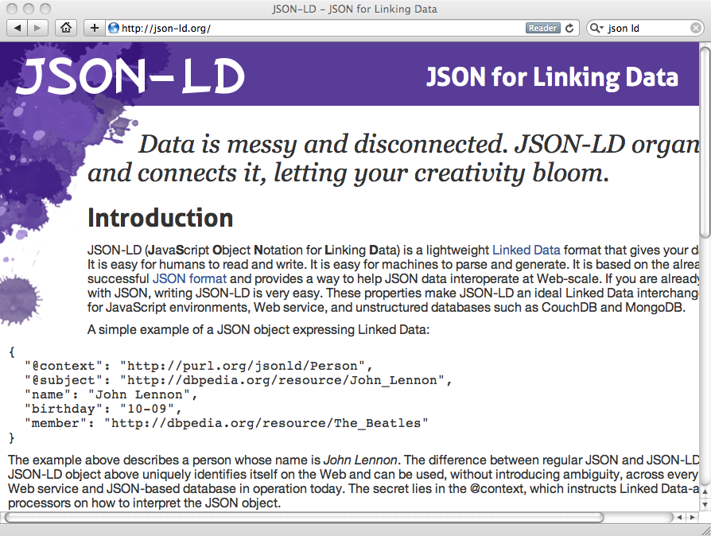

Slide 32
Install
LMS
Tool
Registration
TC Profile
Credit Card
"Buy"
1234
TP Profile
Final
Draft
Got It
Approve
Final
Launch
0.9
0.9
Got It
LTI 2.0

Slide 33
Demonstration of Registration and JSON-LD
https://online.dr-chuck.com/sakai-api-test/

Slide 34
Demonstration of Full LTI 20 Registration Cycle in Sakai
https://www.youtube.com/watch?v=-Dt2Sz5ilLQ

Slide 35
LTI 2.1 – Public Draft
Adds re-registration with pseudo-transactions
Update secrets
Discover new services / capabilities
Split secrets – 512 bits
Improve parsability of the Tool Consumer Profile
Upwards compatible - likely the first release delivered other than Sakai / Moodle

Slide 36
Re-
Register
LMS
Tool
Registration
Final 1
Final 1
TC Profile
TP Profile
half_secret
Possible chit-chat ...
Draft 2
Draft 2
Yes, half_secret
Launch
Draft 2
Draft 2
Approve
Final 2
Commit 2
Launch
Final 2
LTI 2.1

Slide 37
LTI 2.2 – Just a list
What we liked but did not want in 2.1 in order to ship
Tools will provide a "profile of desired and required" before registration.
Tool-initiated re-registration to discover new features

Slide 38
LMS
Tool
Final 1
Final 1
Launch
Re-
Register
TC Profile
TP Profile
Draft 2
Draft 2
Got your draft
Approve
Draft 2
Final 2
Commit 2
Final 2
Launch
LTI 2.2

Slide 39
Investigate
LMS
Tool
TP Info
Install
Registration
TC Profile
TP Profile
Draft 1
Draft 1
Got your draft
Approve
Draft 1
Final 1
Commit 2
Final 1
Launch
LTI 2.2

Slide 40
Common Cartridge 2.0
Is waiting on LTI 2.0/2.1 to make it into the market
Need provisioned LTI tools survive across import / export
Copying URL w/o key/secret → broken links
Tools have resource types
tsugi.org::tsugi_mod_map
Courses and placements have settings that LTI 2.0 tools can set

Slide 41
Caliper – Next Session

Slide 43
www.tsugi.org

